Slide 1

m a t c h w i c h
Final Presentation
Team 22: Sarah Stanish, Will Simpson, Daniel Isaac, Paul John, Samuel Garn

Slide 2
Overview

Slide 3
Matchwich is an application to help people make connection based on their sandwich preferences. This is a fun, safe way to meet your soulmate or just a new friend. This unique way of matching people can lead to interesting conversations and unexpected commonalities!

Slide 4
Specifics
Main Interface:
Interface will be shown after account creation has been completed. Provides a user picture along with brief description of sandwich preferences. Options for accepting or denying the match are given to the user (screenshot on following slide)
Backend Elements:
Database- Using MySQL to store users into a database that is then used to match individuals. All individuals will require the same information.
Matching Algorithm- Selects and pairs an individual to those in nearby areas along with similar tastes in sandwich (screenshot on following slide)

Slide 5
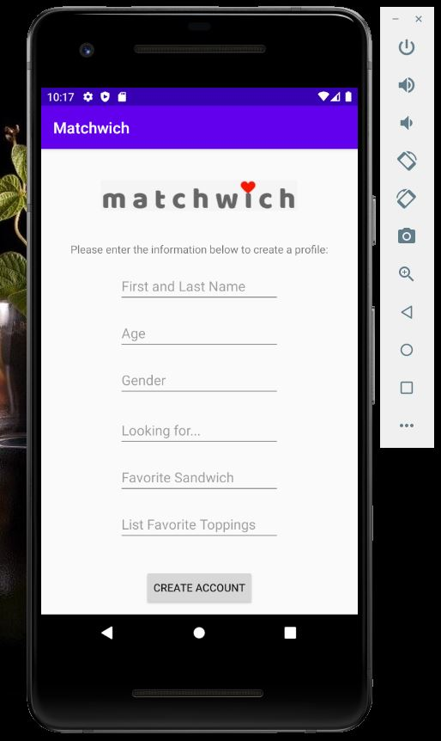
Interface created in Android Studio
The UI consists of 3 views:
Account creation - here users are prompted to enter their information to create an account
Matching Page - here users are presented with potential matches and given the option to match or pass
View Matches Page - here the users can view their matches they have made

Slide 6

UI Demo

Slide 7
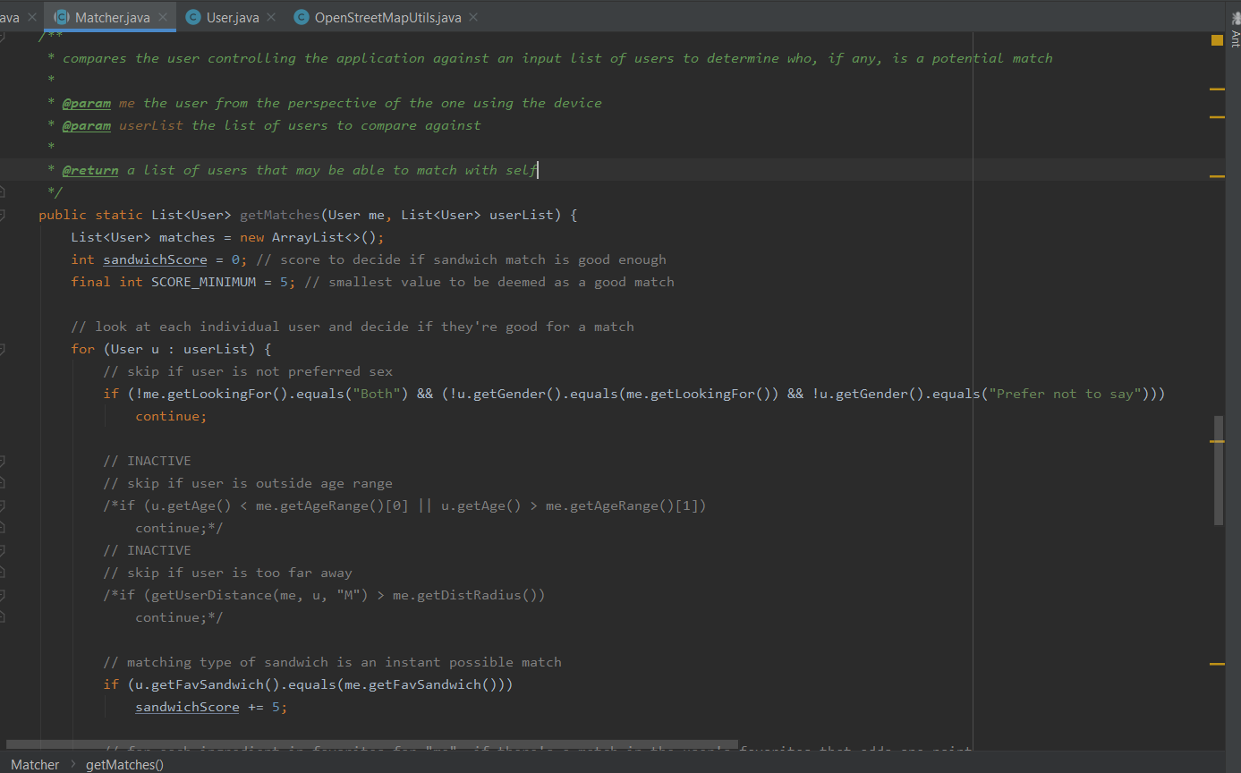
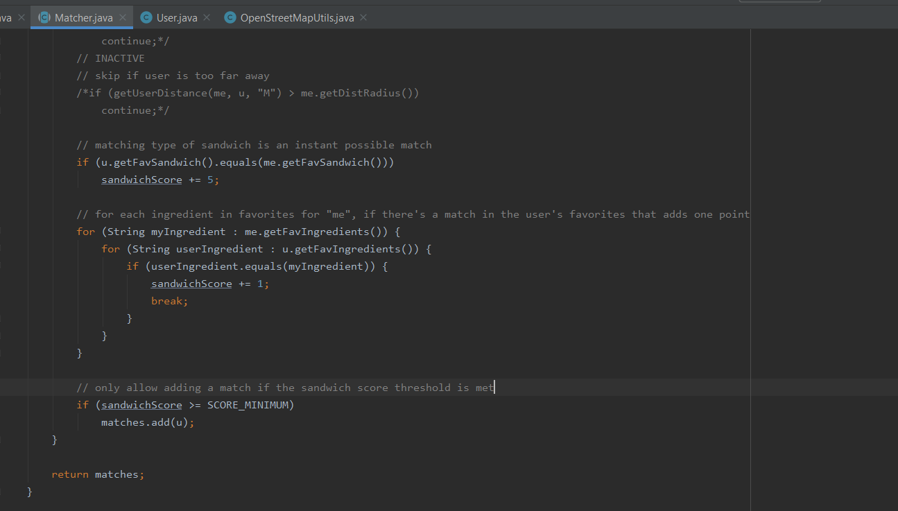
Matching Algorithm in Java
Main feature:
Assign the value of match potential with a “sandwich score”
Score interpreted by comparing favorite sandwich type and favorite ingredients of the sandwich
Minimum score required in order to deem users as potential matches
Algorithm has other basic filters such as omitting users not matching one’s “looking for” gender

Slide 8
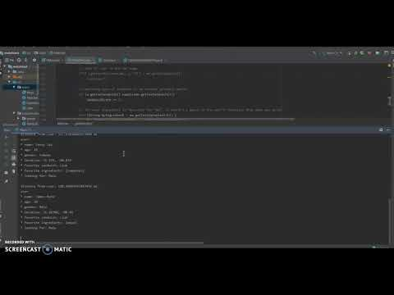
Matching Algorithm Demo

Slide 9
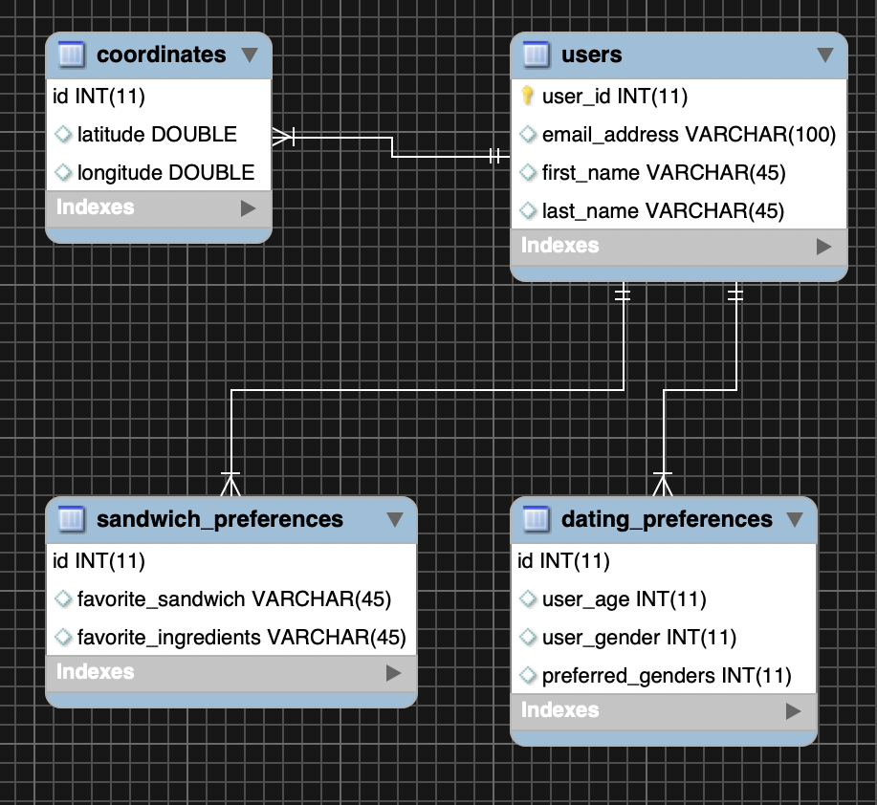
Database created using MySQL
The database was created in MySQL Workbench.
The users table holds sign up information, email and name.
The sandwhich_preferences and dating_preferences hold data that will be used when matching
Coordinates table will hold coordinates used to determine location of users

Slide 11
The Problem
Notes:
So what’s wrong with current apps?

Slide 12
With other dating sites, the amount of personal information required from users is excessive and unnecessary for pairing individuals for a date.
This leads to a lot of privacy issues and could negatively impact the results of the app.
Overall, they can be aggressive and hard-to-use where users are constantly being reminded to continue use of the app and spend money to “super like” or be noticed more.
Notes:
Personal info
Less privacy
Personal mental effort

Slide 13
Our Solution

Slide 14
The simplicity of matchwich requires less personal information from users while still leveraging common ground to pair them up.
Our app minimizes privacy issues, as individuals are only sharing a single thing about themselves.
Less pressure is put on the person(s) to use the app consistently and alleviates the heaviness of dating. While the first date could lead to much more, it could also be an enjoyable lunch with someone who likes the same sandwich.

Slide 15
So What do You
Get Out of It?

Slide 16
What Do You Get Out of It?
Lower Pressure, more privacy, .etc
Big Picture: Effortless
We’re taking out:
Stress of privacy
Mental work and consideration
You can tell others without stigma
You can date on campus
Subway is now a viable dating site
Notes:
Point1 : As Daniel said, it’s lower pressure, more privacy...
But the big picture is, you’re gonna get an app that’s unbelievably effortless.
We’re taking out the stress of privacy, and all the mental work and consideration you have to put in these apps, gone. You can use it without worrying about any of that.
You can tell people you’re using a sandwich-based dating app, and nobody’s going to go, “ew.” They’re going to be amused, they’re going to want to know more.
This isn’t going to be something you have to hide, this is going to be something that you can share and have a fun talk about. Okay?
And if that’s not all, you can date on campus.

Slide 17
Conclusion
Simple, easy to use program
Addresses our problems with current dating apps
Overcome roadblocks such as:
Coding
Documentation
Team Communication

